Slide 1
Chapter 10
Multiple Inheritance and Interface
Learn To Program Java
1

Slide 2
Single Inheritance
Inheritance Mechanism
  extends
  Subclass& Superclass
  java.lang.Object
  Subclass can use Non private attributes and methods of superclass directly
Demo
Super
Method Overriding
Learn To Program Java

Slide 3
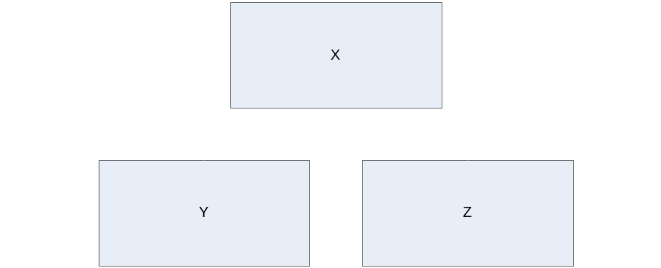
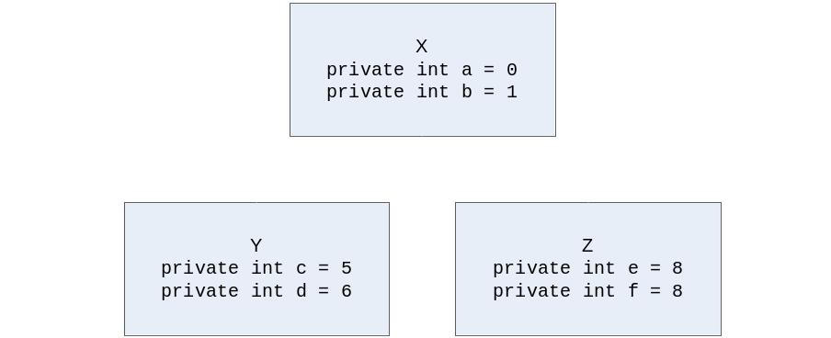
Single Inheritance
Output:
X's a = 0; X's b = 1
Y's a = 0; Y's b = 1
Y's c = 5; Y's c = 5
Z's a = 0; Z's b = 1
Z's e = 8; Z's f = 9
class Chap10singleInheritance {
public static void main(String argv[]) {
X x = new X(); Y y = new Y(); Z z = new Z();
System.out.println("X's a = " + x.getA() +
"; X's b = " + x.getB());
System.out.println("Y's a = " + y.getA() +
"; Y's b = " + y.getB());
System.out.println("Y's c = " + y.getC() +
"; Y's c = " + y.getC());
System.out.println("Z's a = " + z.getA() +
"; Z's b = " + z.getB());
System.out.println("Z's e = " + z.getE() +
"; Z's f = " + z.getF());
}
}
Class Y and Z have more than just 2 variables each.
An object from Class Y has variables a, b, c, and d.
An object from Class Z has four variables: a, b, e, and f.
Variables a and b have been inherited from Class X.
Note that variables c and d are not inherited by Class Z since Class Y and Class Z are siblings on the same level.
class X {
private int a = 0;
private int b = 1;
X() {}
public int getA() {
return a;
}
public int getB() {
return b;
}
}
class Y extends X{
private int c = 5;
private int d = 6;
Y() {}
public int getC() {
return c;
}
public int getD() {
return d;
}
}
class Z extends X {
private int e = 8;
private int f = 9;
Z() {}
public int getE() {
return e;
}
public int getF() {
return f;
}
}
Learn To Program Java

Slide 4
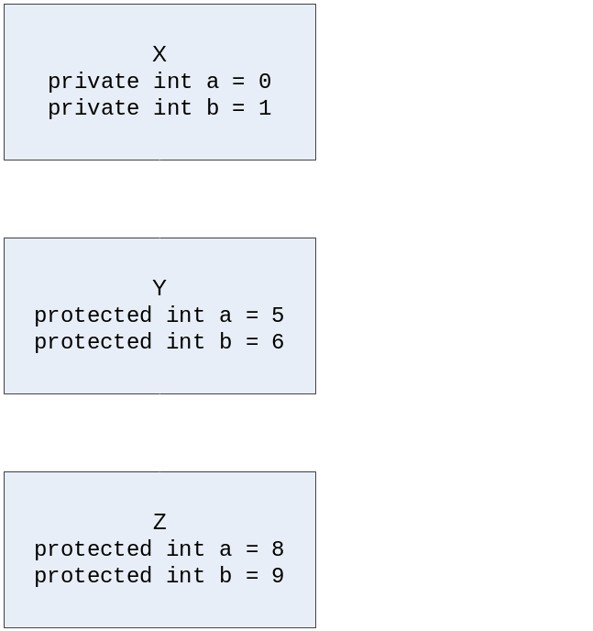
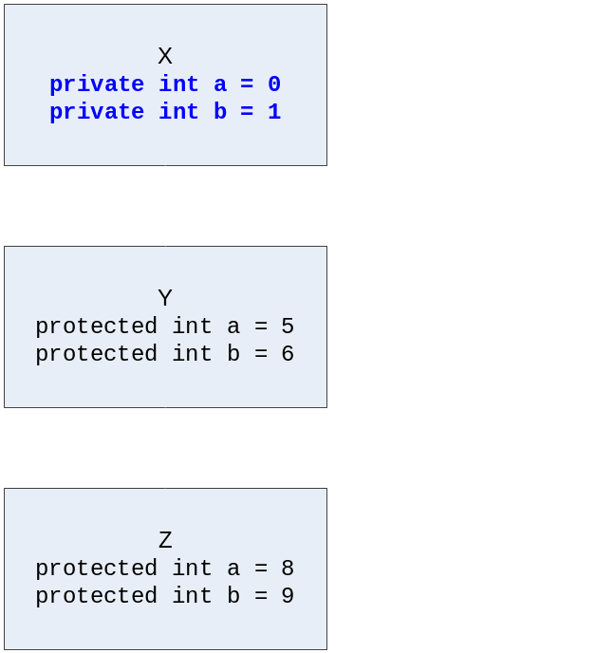
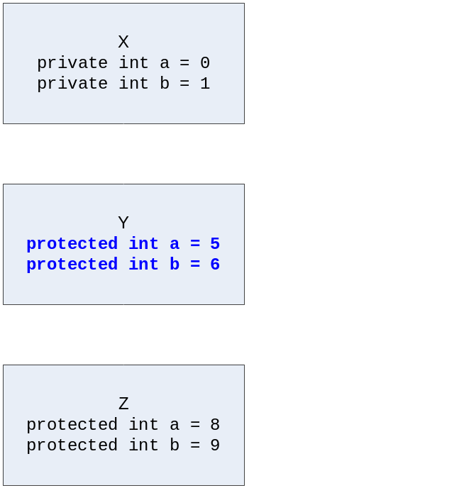
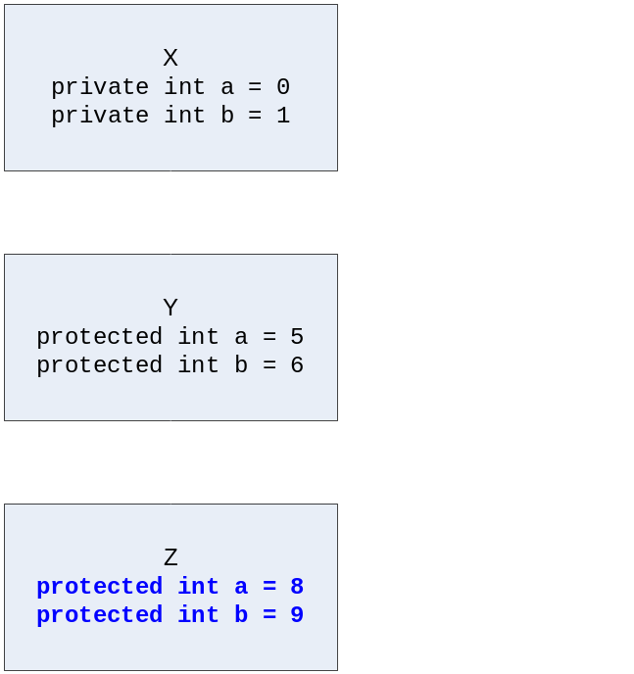
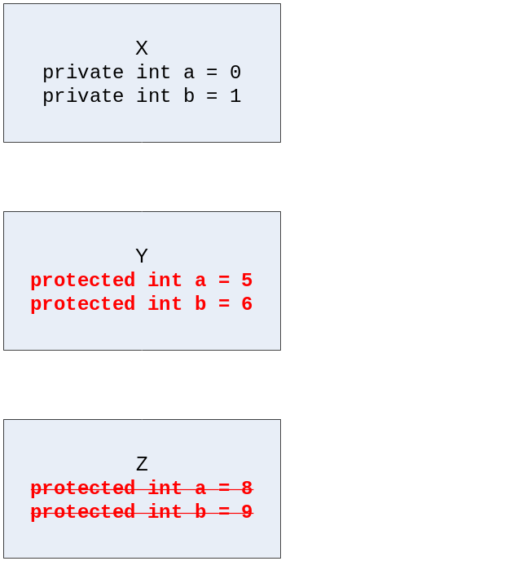
Multi-Level Single Inheritance
class Chap10singleInheritance2 {
public static void main(String argv[]) {
X x = new X();
Y y = new Y();
Z z = new Z();
System.out.println("X's a = " + x.getA() +
"; X's b = " + x.getB());
System.out.println("Y's a = " + y.getA() +
"; Y's b = " + y.getB());
System.out.println("Z's a = " + z.getA() +
"; Z's b = " + z.getB());
}
}
class Chap10singleInheritance2 {
public static void main(String argv[]) {
X x = new X();
Y y = new Y();
Z z = new Z();
System.out.println("X's a = " + x.getA() +
"; X's b = " + x.getB());
System.out.println("Y's a = " + y.getA() +
"; Y's b = " + y.getB());
System.out.println("Z's a = " + z.getA() +
"; Z's b = " + z.getB());
}
}
class Chap10singleInheritance2 {
public static void main(String argv[]) {
X x = new X();
Y y = new Y();
Z z = new Z();
System.out.println("X's a = " + x.getA() +
"; X's b = " + x.getB());
System.out.println("Y's a = " + y.getA() +
"; Y's b = " + y.getB());
System.out.println("Z's a = " + z.getA() +
"; Z's b = " + z.getB());
}
}
class Chap10singleInheritance2 {
public static void main(String argv[]) {
X x = new X();
Y y = new Y();
Z z = new Z();
System.out.println("X's a = " + x.getA() +
"; X's b = " + x.getB());
System.out.println("Y's a = " + y.getA() +
"; Y's b = " + y.getB());
System.out.println("Z's a = " + z.getA() +
"; Z's b = " + z.getB());
}
}
class Chap10singleInheritance2 {
public static void main(String argv[]) {
X x = new X();
Y y = new Y();
Z z = new Z();
System.out.println("X's a = " + x.getA() +
"; X's b = " + x.getB());
System.out.println("Y's a = " + y.getA() +
"; Y's b = " + y.getB());
System.out.println("Z's a = " + z.getA() +
"; Z's b = " + z.getB());
}
}
Objects instantiated from classes X, Y and Z took on the values of variables a and b defined for each class i.e. the value of variable a from object y is the variable a from Class Y and not the variable a from x or z.
Let us now remove the variable definition of variables a and b in Class Z.
The returned value of getA() and getB() in Class Z is that of the variables a and b defined in Class Y.
The methods took on the variables that are closer to it – in this case, the variables a and b from Class Y.
Output:
X's a = 0; X's b = 1
Y's a = 5; Y's b = 6
Z's a = 8; Z's b = 9
Output:
X's a = 0; X's b = 1
Y's a = 5; Y's b = 6
Z's a = 8; Z's b = 9
Output:
X's a = 0; X's b = 1
Y's a = 5; Y's b = 6
Z's a = 8; Z's b = 9
Output:
X's a = 0; X's b = 1
Y's a = 5; Y's b = 6
Z's a = 8; Z's b = 9
Output:
X's a = 0; X's b = 1
Y's a = 5; Y's b = 6
Z's a = 5; Z's b = 6
Learn To Program Java

Slide 5
final keyword
final class can not be inherited
  (用final标记的类不能被继承，太监类)
final method can not be overridden in subclass
  (用final标记的方法不能被子类覆写)
final attributes are contants
  (用final标记的变量是常量)
Learn To Program Java

Slide 6
abstract class
abstract method is a method signature without implementation (i.e. without the braces {..}).
These methods will be implemented (or overridden) by the subclasses. Java Virtual Machine shall use the implementation of the methods in the subclasses at runtime. This capability is known as dynamic binding .
A class that has an abstract method must be declared as an abstract class via the abstract keyword.
Learn To Program Java

Slide 7
Abstract class
All subclasses of an abstract class must implement (or override) any abstract methods defined in the superclass unless the subclass is defined as an abstract class itself.
An abstract class is a class that does not have instances
Learn To Program Java

Slide 8
Multiple Inheritance
Class Z has two parents – Class X and Class Y.
Whatever variables and methods defined in Class X and Class Y are technically properties available in Class Z.
X
variable: a
method: getA()
Y
variable: a
method: getA()
Z
Problems:
The variable and method names are the same, there is ambiguity
Which of these properties should Class Z inherit?
To avoid such ambiguity in implementation, Java does not support Multiple Inheritance.
Java, however, provides an alternative approach. It uses a construct known as Interface.
Learn To Program Java

Slide 9
Contract and Implementation
An object’s method can be described as consisting of two parts: Contract and Implementation.
The contract of a method defines the name of the method, the number and type of formal parameters, and the return type.
The name of the method, and the number and type of formal parameters together is known as the method signature
The implementation of a method is made up of a set of statements that defines the behaviour of the method.
It is through the implementation that the state of an object is changed or returned.
Learn To Program Java

Slide 10
Ambiguity Problem Revisited
At first glance, it may not seem to be a problem since the contracts of the two methods are the same. Class Z could inherit from either one of the getA() methods.
However, the implementation of the two methods may be different.
Class Z cannot arbitrarily take on either of the getA() methods.
X
variable: a
method:
getA()
{a++;return a;}
Y
variable: a
method:
getA()
{return a;}
Z
Solution: Allow a subclass takes on the contract of a method in the superclass without any implementation.
The implementation of the method will be provided at run-time and decided by the subclass.
Java provides for this mechanism via the Interface construct.
Learn To Program Java

Slide 11
Interface
An interface is a construct that defines agreed-upon behavior that other objects use to interact with one another.
It is a named collection of method definitions (contracts) that do not have implementations.
The implementation of the methods is provided by the class of objects that choose to implement the behavior.
Learn To Program Java

Slide 12
Understanding Interface
class X {
private int a = 2;
private int b = 3;
X() {}
protected int getA() {
return a;
}
protected int getB() {
return b;
}
}
interface Y {
int a = 5;
int getA();
}
interface Y {
int a = 5;
int getA();
}
class Z extends X implements Y {
Z() {}
public int getA() {
return (super.getA() * 2) + a;
}
}
class Z extends X implements Y {
Z() {}
public int getA() {
return (super.getA() * 2) + a;
}
}
class Z extends X implements Y {
Z() {}
public int getA() {
return (super.getA() * 2) + a;
}
}
Learn To Program Java

Slide 13
Defining Interface
An interface definition uses the interface keyword.
All methods in an interface are abstract methods.
Only the contract definition is specified in an interface.
interface I {
int a = 5;
// constant declaration
int getA();
// method with no
// implementation
int getB();
// another method with no
// implementation
}
The implementation is provided by the subclass that implements it.
An interface can also include constant declaration.
Learn To Program Java

Slide 14
Defining Interface (cont)
An interface has two components – interface declaration and interface body.
Interface Declaration 
interface I
Interface Body 
{
int a = 5;
int getA();
int getB();
}
Learn To Program Java

Slide 15
Interface Declaration
An interface declaration specifies the name of the interface and other superinterfaces that the interface extends.
interface I extends J, K, L
A class can only extend from a superclass but an interface can extend from any number of interfaces.
An interface declaration may also include the public access specifier.
An interface with the public access specifier is accessible by any class in any package.
Learn To Program Java

Slide 16
Interface Body
An interface body contains constant and method declarations.
A method declaration is the contract part of a method. Declaration of a method ends with a semicolon (;) without the braces ({}) because the implementation part of the method is not required in interfaces.
All methods declared are, by default, considered as public and abstract.
The use of the private and protected access specifier is not allowed on members of an interface.
Learn To Program Java

Slide 17
Implementing Interface
A class that implements an interface has to provide the implementation part of the methods in the interface as well as those in its superinterfaces.
If the class does not implement all the methods in the interfaces, it must be declared as abstract.
The method signature in the implementing class must match the method signature declared in the interfaces.
Code Example
Learn To Program Java

Slide 18
Application of Interface - Comparable
An object that implements the Comparable interface is said to have the capability to compare itself to another object of the same type.
Classes that implement comparable have to provide a method “compareTo()”.
Interface
Package
Method
Description of Method
Comparable
java.lang
public int compareTo (object o)
Compares this object with the specified object for order. Returns a negative integer, zero, or a positive integer as this object is less than, equal to, or greater than the specified object.
Learn To Program Java

Slide 19
Using Comparable
An employee of a company has three attributes: name, age, and basic salary. A sales person is a specialized type of employee. Like all other employees, a sales person has the three attributes plus an additional attribute: commission. There are five sales persons and their data.
Name | Age | Basic Salary | Commission
John | 25 | 1500 | 2300
Mary | 18 | 3000 | 3000
Jack | 15 | 600 | 6000
Billy | 40 | 4000 | 1500
Kit | 32 | 6800 | 400
Develop an application to provide for three sort methods on sales persons based on the natural ordering of their age, name and wage.
Learn To Program Java

Slide 20
Using Comparable (cont)
abstract class Employee {
private String name;
private int age;
private int basicSalary;
......
......
}
Class Employee is defined as an abstract class because no object could be instantiated from Employee.
To sort the list of five sales persons, we need to have a means for comparing SalesPerson objects
class SalesPerson extends Employee {
private int commission;
......
......
}
Class Employee is defined as an abstract class because no object could be instantiated from Employee.
To make a SalesPerson comparable, we extend the SalesPerson class by implementing the Comparable interface.
A SalesPerson is thus not only an Employee, it is also an object that can be compared with another SalesPerson object.
Learn To Program Java

Slide 21
Using Comparable (cont)
To implement the Comparable interface, SalesPerson has to provide the implementation for compareTo() method. Two objects are compared based on the age attribute in the compareTo() method.
class SalesPerson extends Employee implements Comparable {
......
public int compareTo(Object o) {
if (this.getAge() < ((SalesPerson) o).getAge())
return -1;
else if (this.getAge() > ((SalesPerson) o).getAge())
return 1;
return 0;
}
}
class Chap10interfaceExample {
public static void main(String[] args) {
SalesPerson personArr [] = new SalesPerson[5];
......
Arrays.sort(personArr);
}
}
Learn To Program Java

Slide 22
Application of Interface - Comparator
The application requires the SalesPerson objects to be sorted via their names.
We have already implemented the Comparable interface. Since there is only one compareTo() method that can be implemented, we have a problem in implementing sort based on name and wage.
One solution is to define a comparator that is capable of comparing two objects and determine their natural order.
Interface
Package
Method
Description of Method
Comparator
java.util
public int compare (object o1, object o2)
public boolean equals (Object obj)
Compares its two arguments for order. Returns a negative integer, zero, or a positive integer as the first argument is less than, equal to, or greater than the second.
Indicates if object obj is equal to this Comparator
Learn To Program Java

Slide 23
Using Comparator
The SortPersonByName is a class that implements the Comparator interface. It is thus a comparator by definition.
class SortPersonByName implements Comparator {
public int compare(Object o1, Object o2) {
SalesPerson p1 = (SalesPerson) o1;
SalesPerson p2 = (SalesPerson) o2;
return p1.getName().toLowerCase().compareTo
(p2.getName().toLowerCase());
}
}
class Chap10interfaceExample {
public static void main(String[] args) {
.....
Arrays.sort(personArr, new SortPersonByName());
.....
}
}
Learn To Program Java

Slide 24
Using Comparator (cont)
class SortPersonByWage implements Comparator {
public int compare(Object o1, Object o2) {
SalesPerson p1 = (SalesPerson) o1;
SalesPerson p2 = (SalesPerson) o2;
int wage1 = p1.getBasicSalary() + p1.getCommission();
int wage2 = p2.getBasicSalary() + p2.getCommission();
return ((wage1 < wage2) ? -1 : (wage1 > wage2) ? 1 : 0);
}
}
class Chap10interfaceExample {
public static void main(String[] args) {
.....
Arrays.sort(personArr, new SortPersonByWage());
.....
}
}
Learn To Program Java

Slide 25
Application of Interface - Serializable
When the program ends, the objects are destroyed.
Whatever state the objects might be in is lost forever.
One way to retain the values of objects beyond program execution is to store the state of the objects into secondary storage.
Java does this by providing a facility known as serialization.
Learn To Program Java

Slide 26
Serializable Interface
Classes can be defined as serializable if they implement the java.io.Serializable interface. This interface is available in the Java API.
The Serializable interface does not have any methods or fields.
By implementing the java.io.Serializable interface, a class is identifying to the Java Virtual Machine that it is serializable.
All subclasses of a serializable class are themselves serializable.
Example
Learn To Program Java

Slide 27
Uses of Interfaces
Capturing behaviour without forcing class relationship.
Providing a place for defining methods that classes are expected to implement.
Provides a front for objects to publish the constant and method definitions without revealing their classes.
Learn To Program Java

Slide 28
Summary
Single Inheritance. A situation in which a class is defined as a subclass that has only one parent class.
Multiple Inheritance. A situation that is similar to Single Inheritance but with the subclass inheriting properties from more than one superclasses.
The contract of a method defines the name of the method, the number and type of formal parameters, and the return type. It specifies what the method can do.
The name of the method, and the number and type of formal parameters together is known as the method signature.
An implementation of a method is the set of statements that defines the behaviour of the method.
An Interface is a named collection of method definitions (contracts) that do not have implementations. The implementation of the methods is provided by the class of objects that choose to implement the behaviour.
Learn To Program Java

